Slide 1
Superficial Cancer of the Esophagus and GE Junction

Slide 2

Anatomy
Food moves from the throat
$→$ esophagus
$→$ stomach
$→$ small bowel (jejunum)

Slide 3
Types of Esophageal Cancer
There are two common types of esophageal cancer
Adenocarcinoma
Squamous Cell Carcinoma
In many ways, these to different types of esophageal cancer behave the same.
We will see later in this video, however, that the treatment can be different depending upon whether the cancer is adenocarcinoma or squamous cell carcinoma.

Slide 4
Cancer Staging
Staging refers to the tests to determine
How large is the tumor?
Has there been spread to lymph nodes?
Has it spread to other parts of the body?
Treatment options depend upon the cancer stage

Slide 5
Esophageal Cancer Staging
T = Tumor - How deep has cancer grown into the wall of the esophagus?
N = Nodes - Has cancer spread to the lymph nodes?
M = Metastasis - Has the cancer spread to other parts of the body? lungs or liver?

Slide 6
Layers of the Wall of the Esophagus
Mucosa - Inner layer
Muscle Wall (muscularis)
Lymph nodes located in fat outside the muscle

Slide 7
Early Stage Cancers
Cancers start on the very inside of the layer called the mucosa

Slide 8
Locally-advanced Cancers
Over time, cancers can grow into the muscular wall

Slide 9
Lymph Nodes
In some cases, cancer cells can break off from the main tumor and spread to lymph nodes

Slide 10

T Stage
Cancers are categorized based upon the thickness of the tumor, known as the T stage

Slide 11

N Stage
Cancers are categorized by whether there is spread to the lymph nodes.
N0 cancers have not spread to the lymph nodes
N1 cancers have spread to the lymph nodes.

Slide 12

M Stage
Some cancers can also spread from the esophagus to the lungs or liver
M0 cancers have not spread to other parts of the body
N1 cancers have spread to other parts of the body such as lungs or liver

Slide 13

PET scan
A PET scan is similar to a CT scan, and uses a small amount of tracer to light up areas of cancer.

Slide 14

Endoscopic Ultrasound
Endoscopic ultrasound (EUS) is a procedure similar to upper endoscopy (EGD) which has an ultrasound probe at the bottom of the scope. This allows measuring the thickness of the cancer. Endoscopic ultrasound can help determine the T stage of the cancer.

Slide 15

Laparoscopy
Some esophageal cancers can spread inside the abdominal cavity. These areas of spread can be very small, as small as a grain of rice.
In order to detect spread within the abdominal cavity, a proceduce called a laparoscopy can be performed in some some patients.

Slide 16
Laparoscopy
A laparoscopy is performed under a general anesthetic.
Several incisions 1/4” long
A telescope is inserted to look inside the abdominal cavity.
Biopsies can be performed.

Slide 17
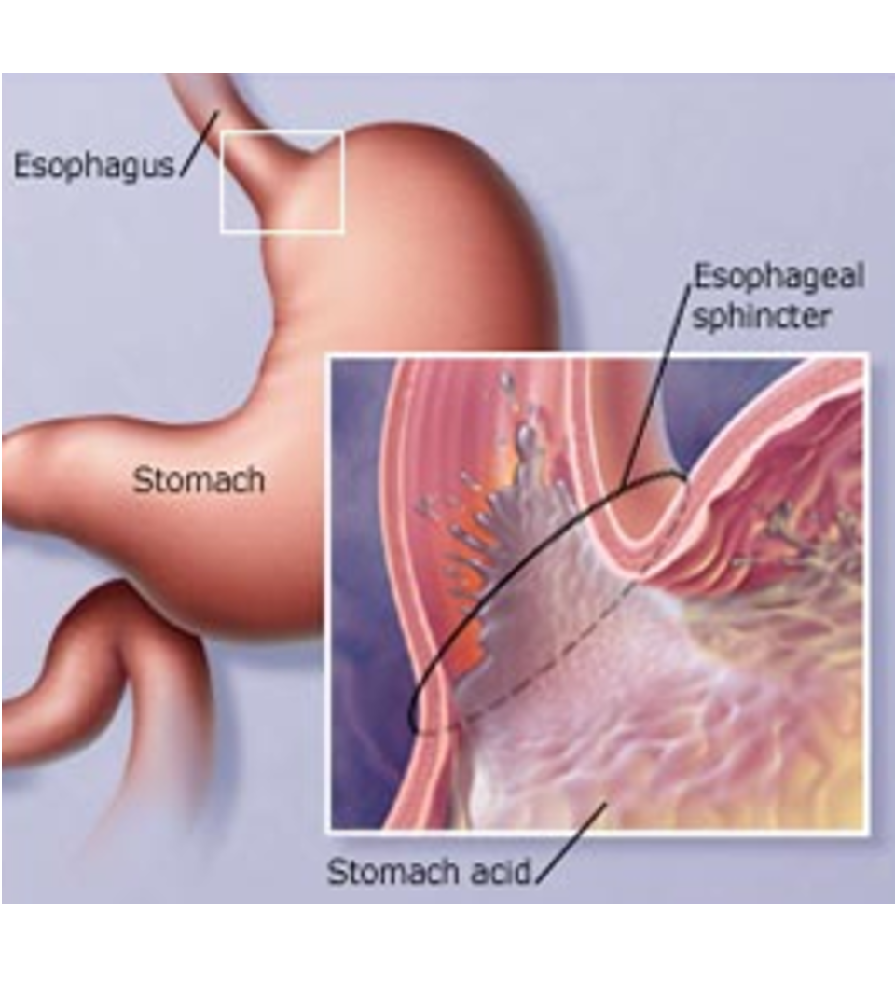
Gastroesophageal Reflux
A one-way valve normally keeps acid within the stomach and prevents it from entering the esophagus

Slide 18
Gastroesophageal Reflux
A one-way valve normally keeps acid within the stomach and prevents it from entering the esophagus
If the valve does not work properly, acid can enter the esophagus and cause heartburn and damage to the lining of the esophagus.

Slide 19
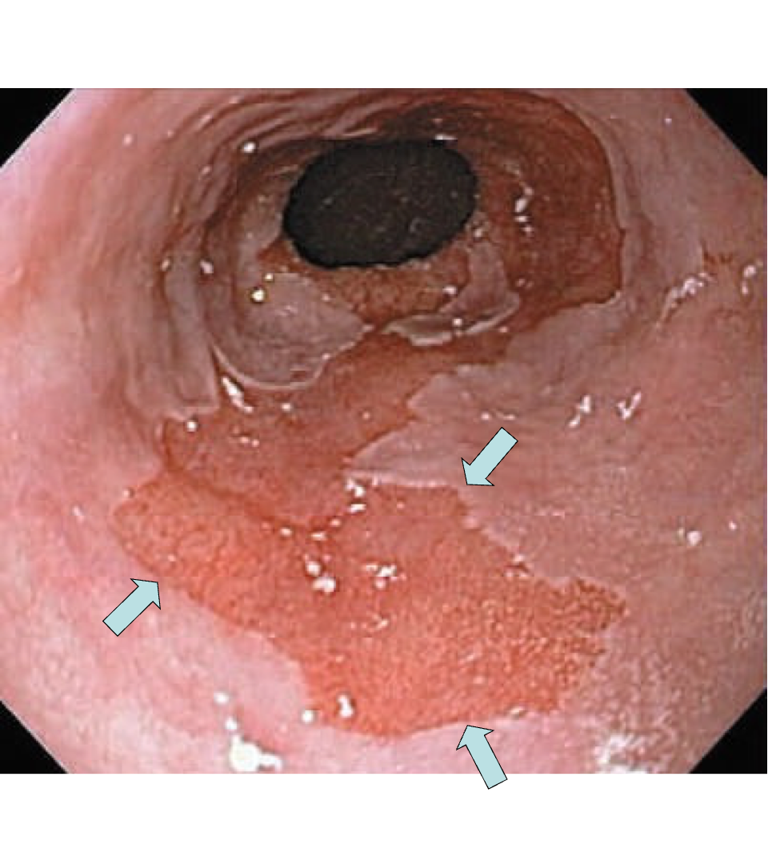
Barrett’s Espohagus
Over time, the lining of the esophagus undergoes change in response to the acid.

Slide 20
Dysplasia
Over a period of years, pre-cancerous changes can develop within Barrett’s esopahgus.
These changes can be seen by the pathologist from biopsies taken from the esophagus
Over time, low-grade dysplasia can progress to high-grade dysplasia

Slide 21
Dysplasia $→$ Cancer
Low grade dysplasia: Risk of cancer 0.5% per year
High-grad dysplasia: Risk of cancer 5% per year
$⇒$ Surveillance with upper endoscopy is critical

Slide 22
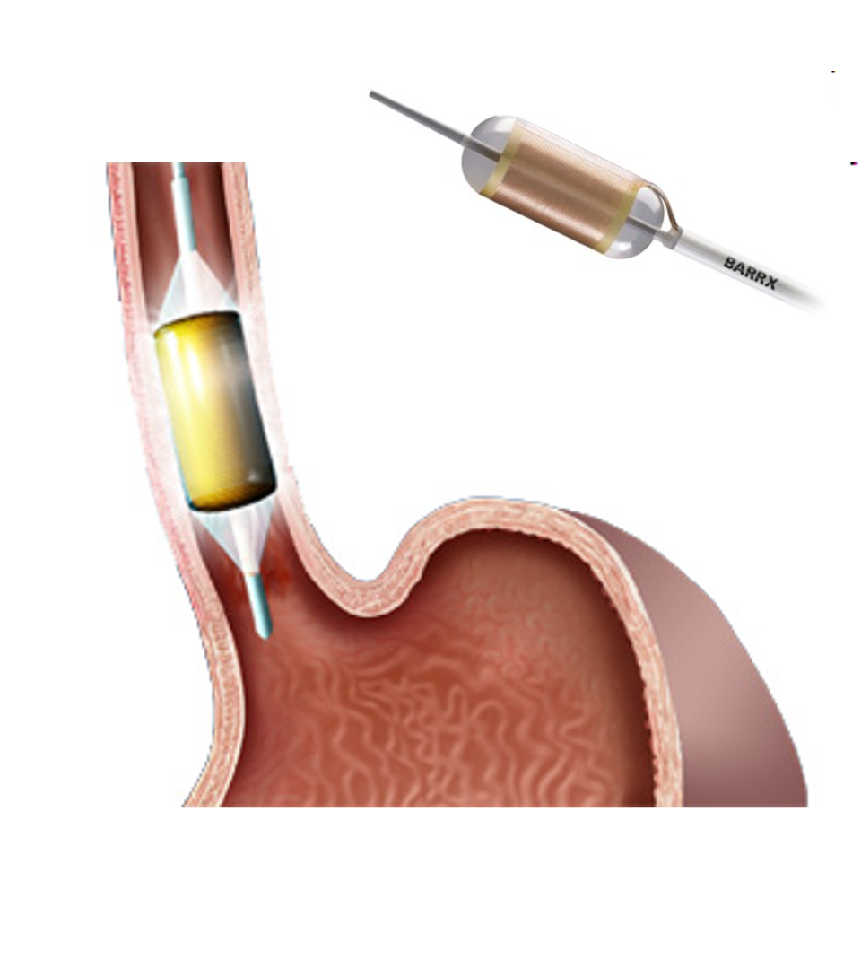
Radiofrequency ablation for Dysplasia
Dysplasia of the esphagus can be treated with destroying the mucosa, the inner layer of esophgus
Ablation of the mucosa with microwave energy
Circular balloon with an antenna used to ablate the mucosa

Slide 23
Radiofrequency ablation for Dysplasia
Before Ablation
After Ablation

Slide 24
Treatment Plans
Superficial (T1) $⇒$ Endoscopic Therapy
Localized (T1b/T2) $⇒$ Surgery
Locally-advanced (T3/N1) $⇒$ Chemo $±$ Radiation $→$Surgery
Metastatic (M1) $⇒$ Chemotherapy

Slide 25
Superficial Cancers
Superficial Cancers = T1a N0
Treatment is often with endoscopy without the need for surgery.

Slide 26
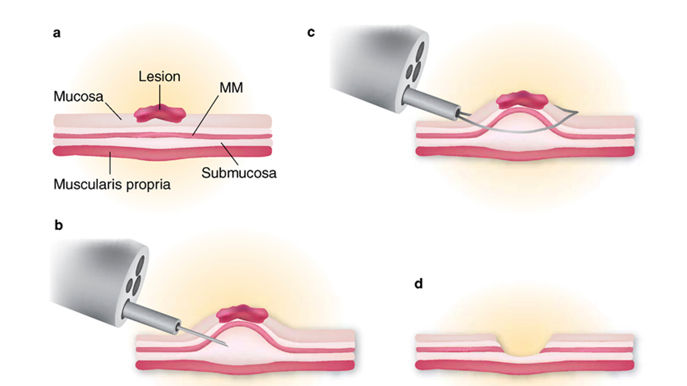
Endoscopic Mucosal Resection (EMR)
Endoscopic procedure to remove a superficial tumor from the inner layer of the esophagus

Slide 27
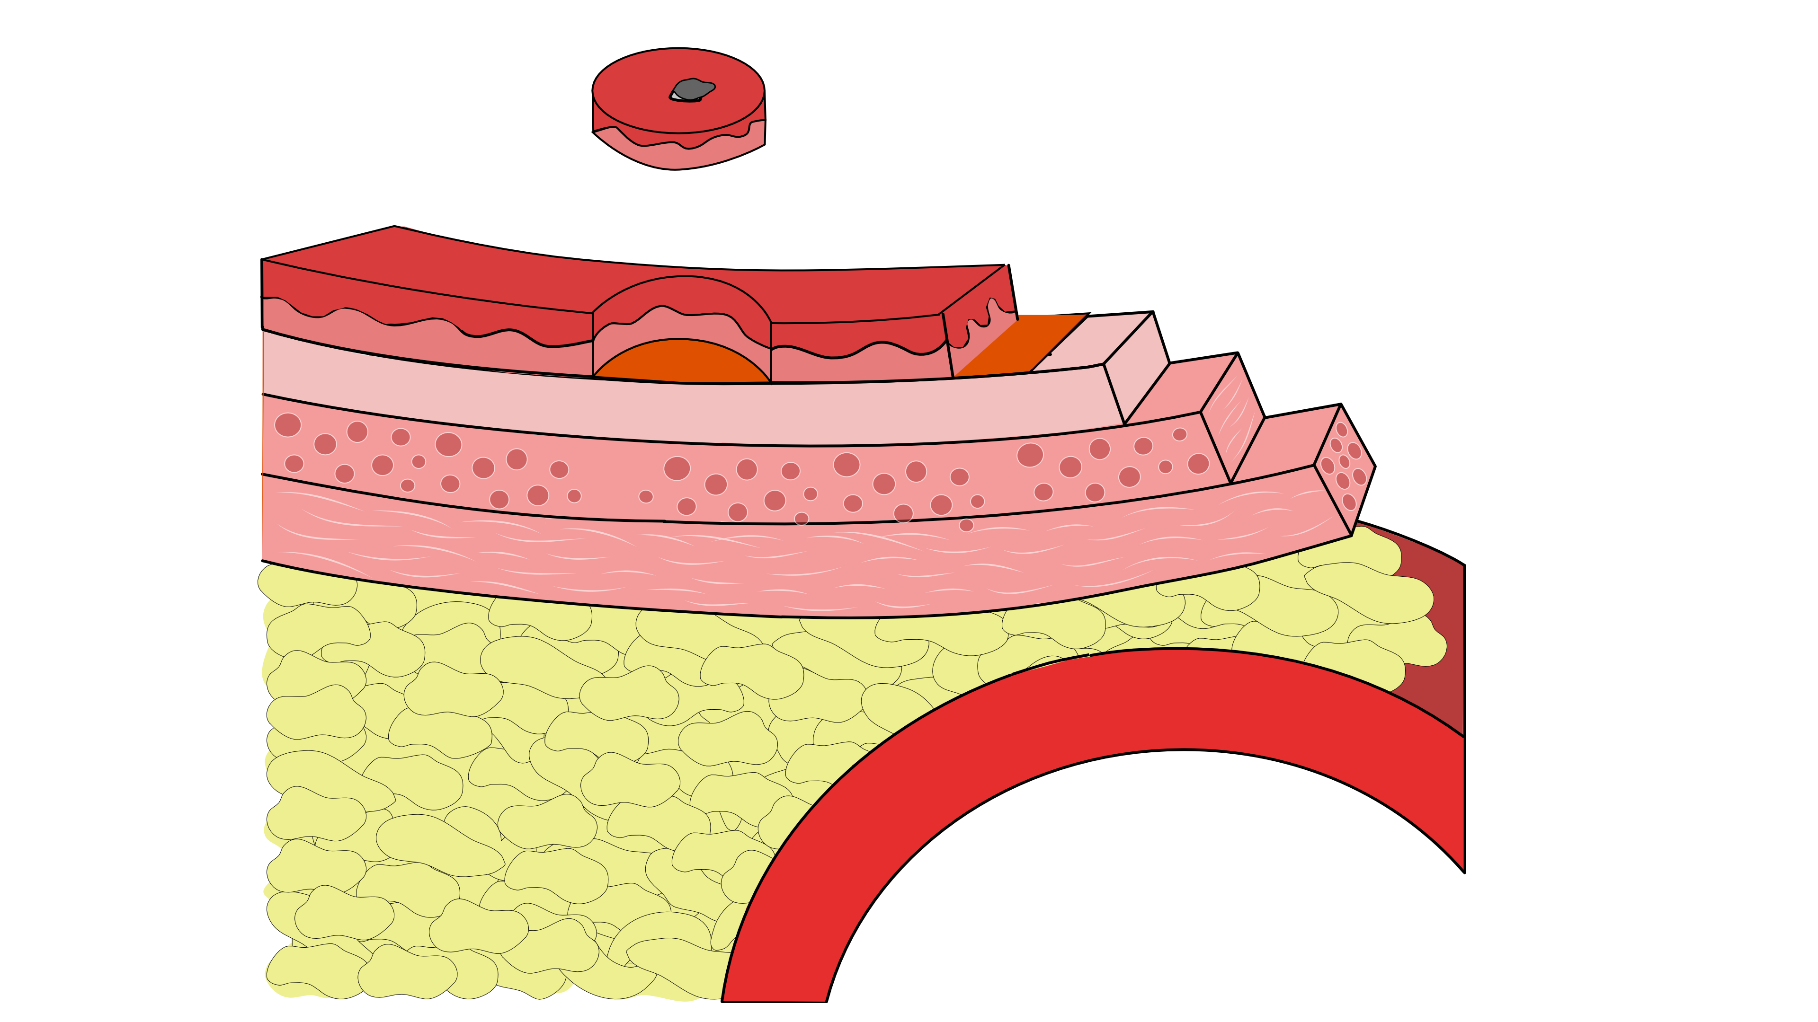
Endoscopic Mucosal Resection - Favorable
Clear margins at the edge AND
Clear deep margin AND
Tumor appears slow-growing under microscope

Slide 28
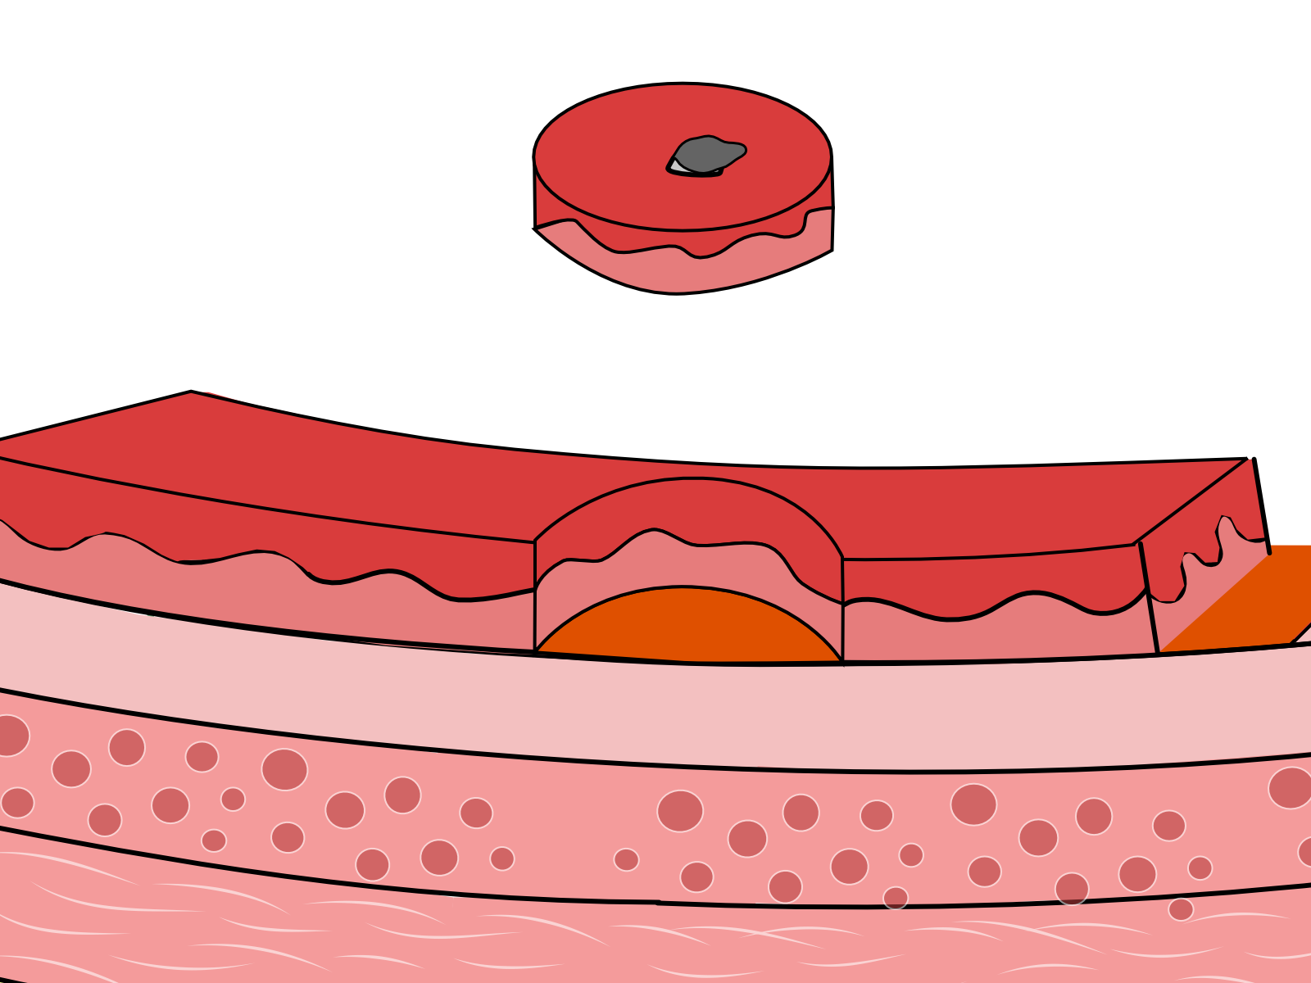
Endoscopic Mucosal Resection - Favorable
Clear margins at the edge AND
Clear deep margin AND
Tumor appears slow-growing under microscope

Slide 29
EMR may be sufficient treatment (without surgery)

Slide 30
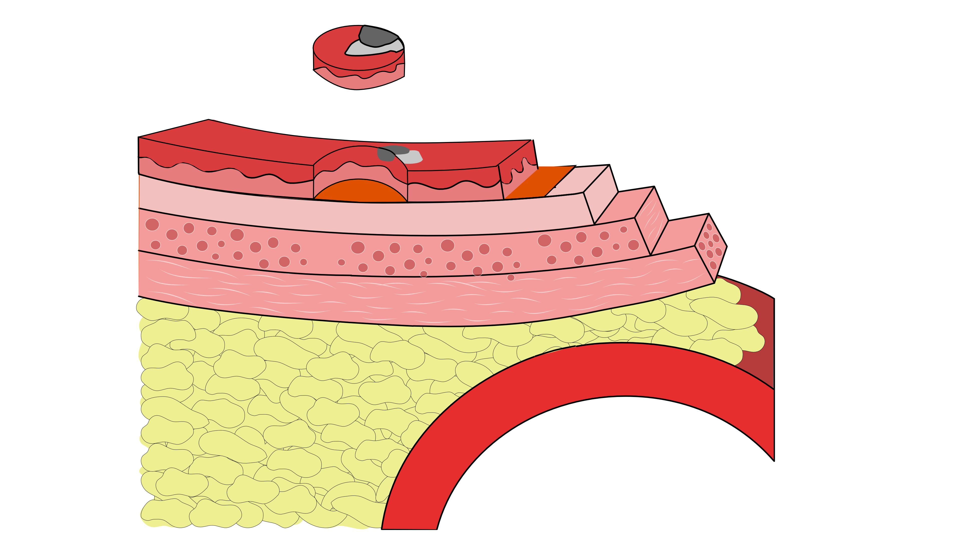
Endoscopic Mucosal Resection - Unfavorable
Tumor at edge margin OR
Tumor at deep margin OR
Tumor appears rapidly-growing under microscope

Slide 31
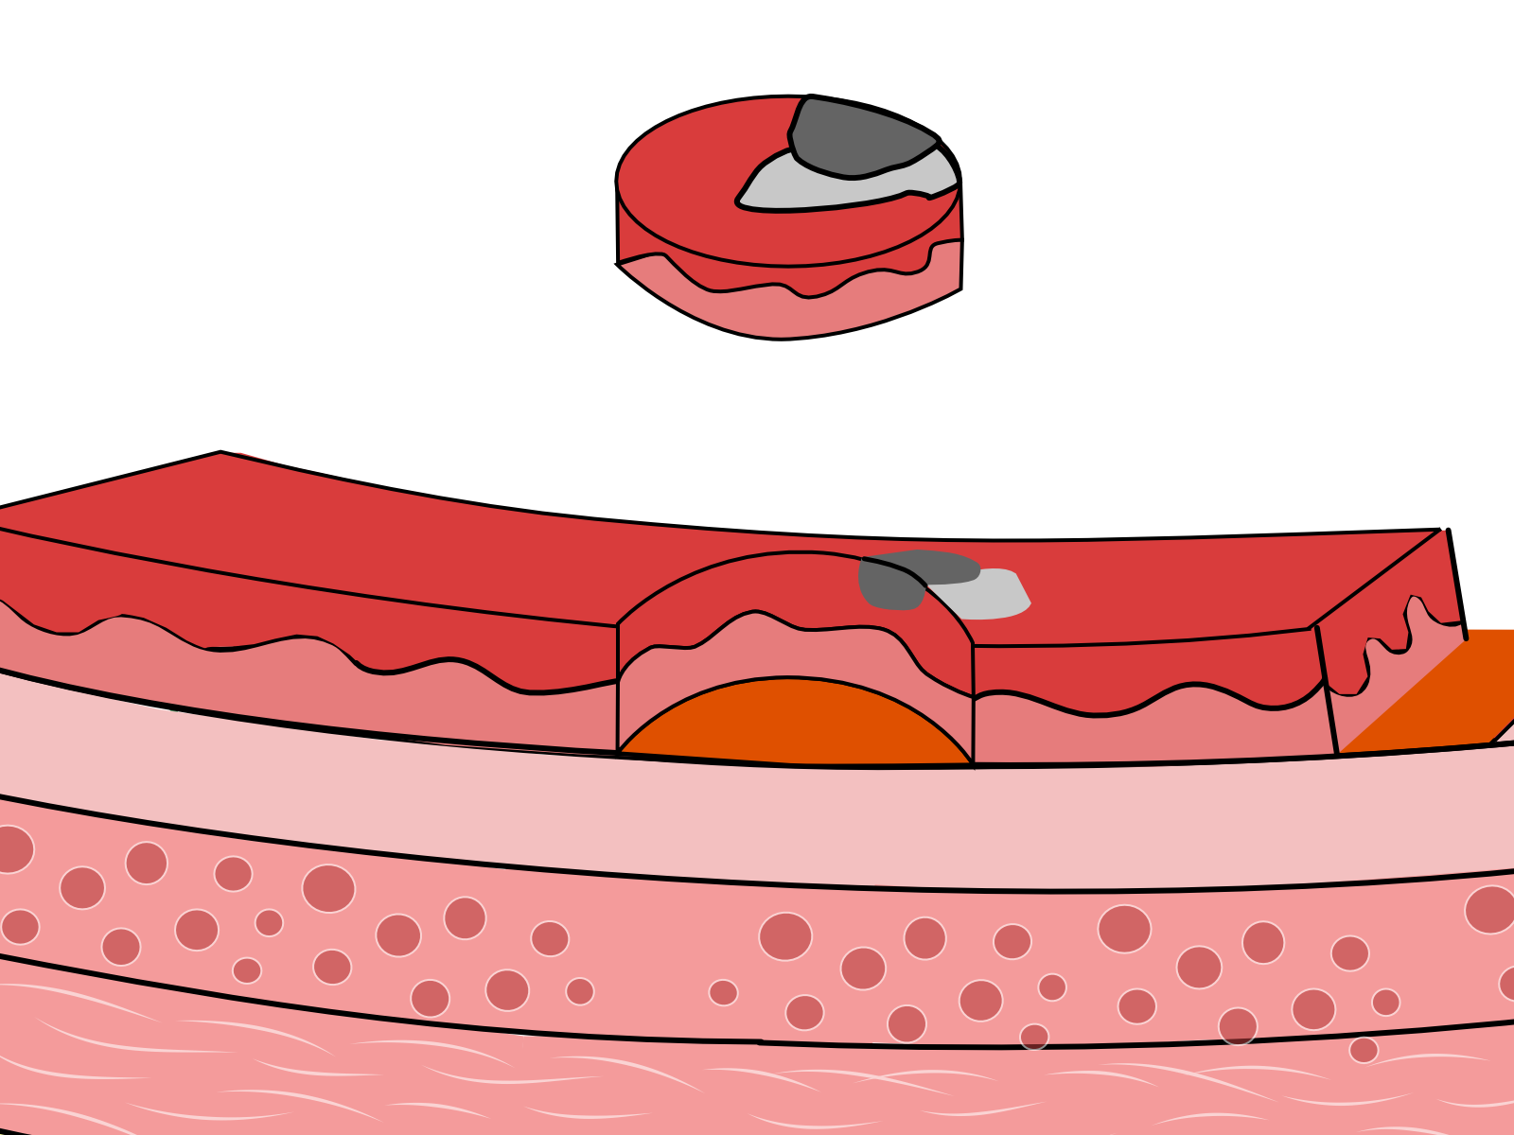
Endoscopic Mucosal Resection - Unfavorable
Tumor at edge margin OR
Tumor at deep margin OR
Tumor appears rapidly-growing under microscope

Slide 32
Esophagectomy (surgery) is standard recommendation

Slide 33
Surgery
Surgery Slideshow

